Slide 1
Skew heaps

Slide 2
Background
Leftist heaps maintain balance by ensuring that the minimum null-path length is always greatest with a left sub-tree
Can we do this without the intermediate calculation?

Slide 3
An Idea
Rather than explicitly computing the minimum null-path length, consider an alternative idea:
Alternate between which sub-heap the merge occurs with
This may not result in a balanced tree as with a leftist heap; however, the amortized run-time analysis will demonstrate that the expected long-term behaviour is logarithmic

Slide 4
Merging
We will demonstrate an algorithm for merging two skew heaps
Once we have a merging algorithm, like leftist heaps, we can implement push and pop in terms of merges:
Push is implemented as merging the skew heap with a node being inserted treated as a trivial leftist heap
Pop is implemented by removing the root node and then merging the two sub-heaps

Slide 5
Merging
Merging two skew heaps uses the following rules:
Given two skew heaps, choose that heap with the smaller:
Swap its children, and
If the left child is empty, let the other heap be that sub-heap, otherwise
Merge the left sub-heap with the other heap

Slide 6
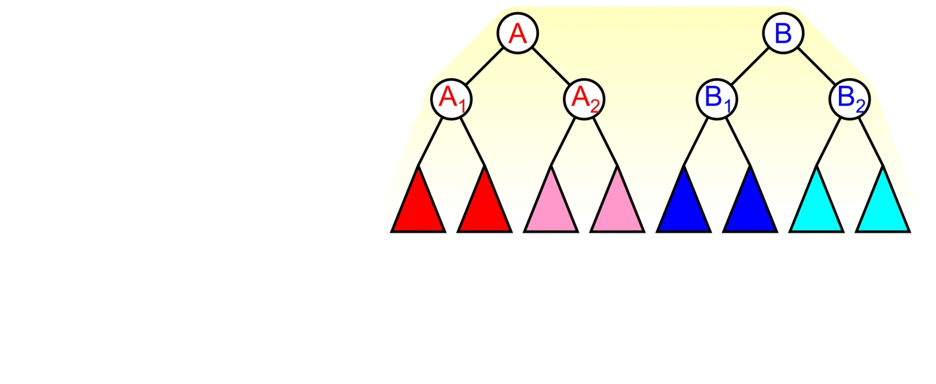
Merging
Suppose we are merging these two heaps:
We see A < B so the heap A will form the root

Slide 7
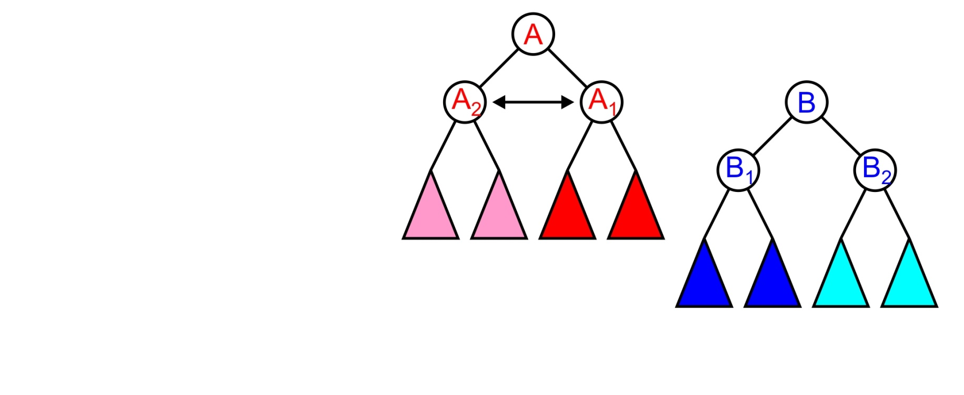
Merging
The next step is to swap the children of A

Slide 8
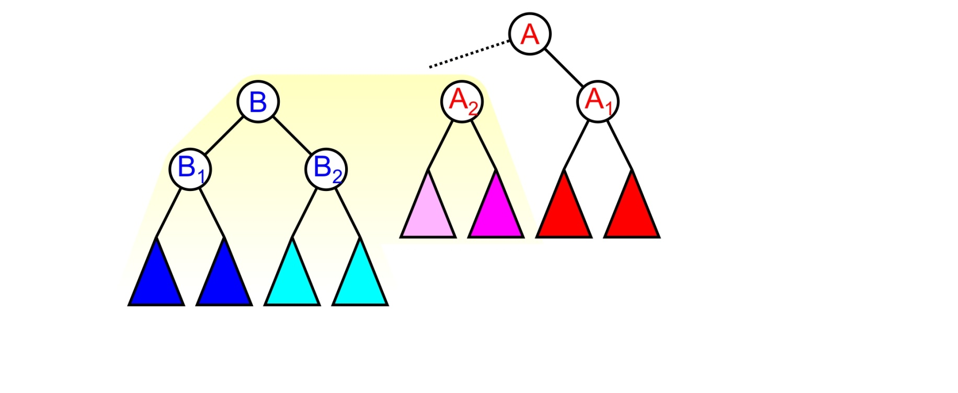
Merging
After which we will merge the heap B with the heap A₂

Slide 9

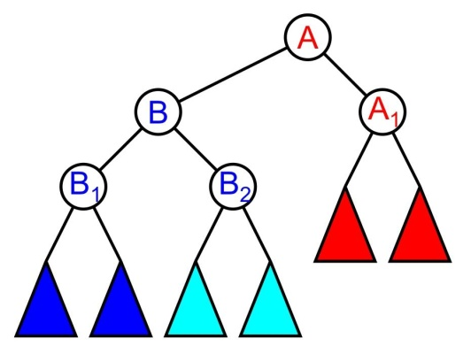
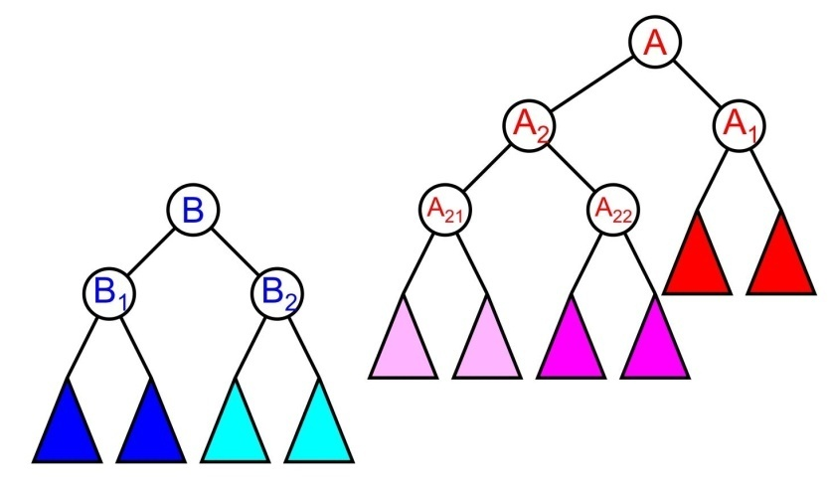
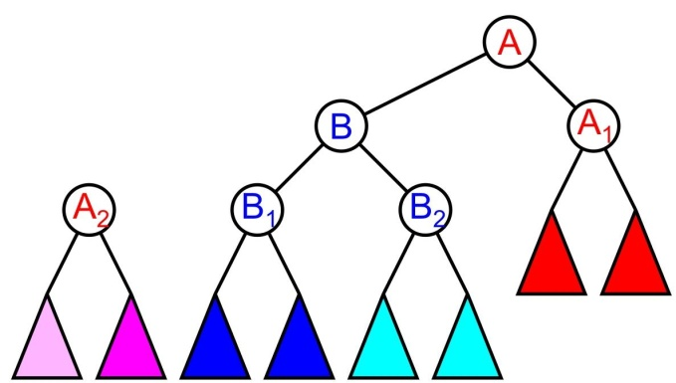
Merging
There are three possibilities:
A₂ is empty
A₂ ≤ B
B < A₂

Slide 10
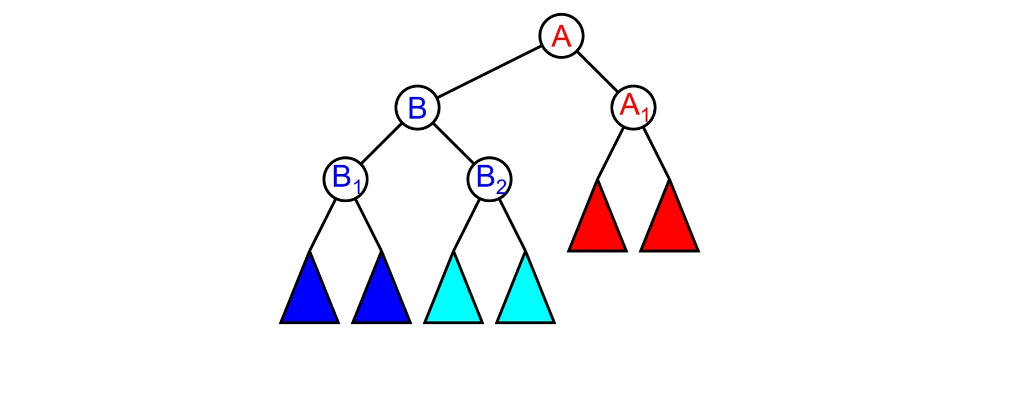
Merging
If A₂ was empty, we simply attach the heap B

Slide 11
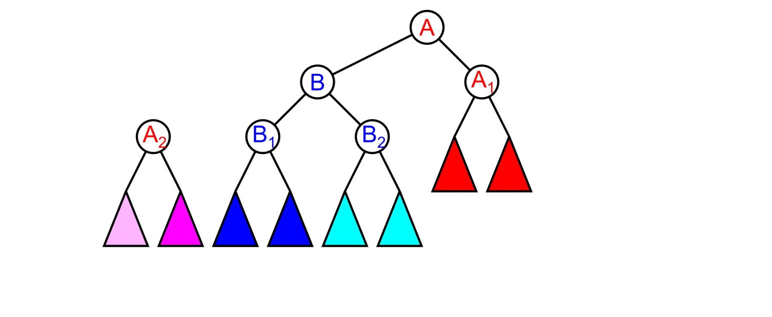
Merging
If B < A₂, we proceed by making heap B the left sub-heap of A

Slide 12
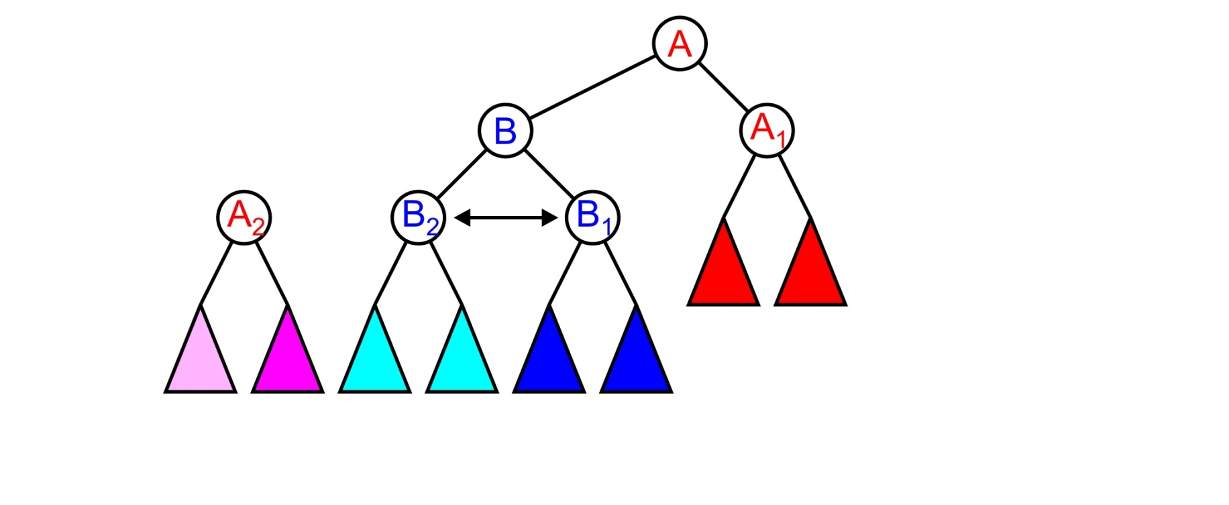
Merging
We would continue by swapping the children of B

Slide 13
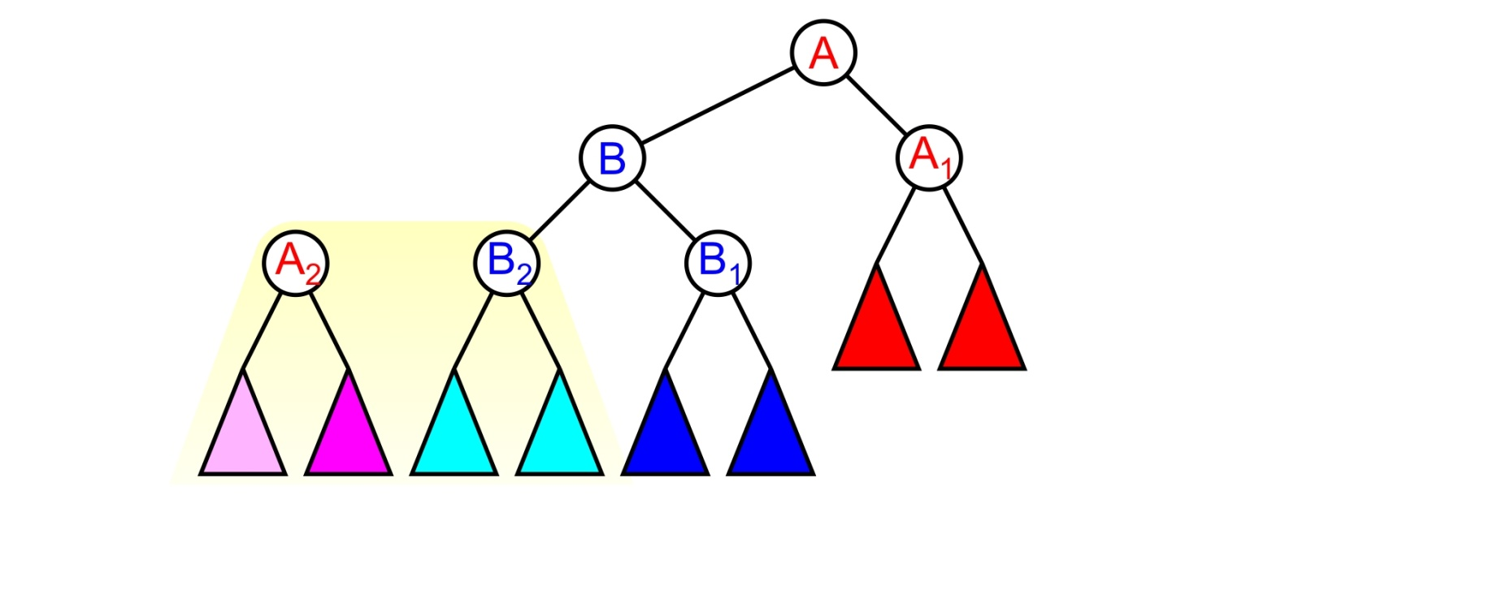
Merging
And the next step would be to merge the heaps A₂ and B₂

Slide 14
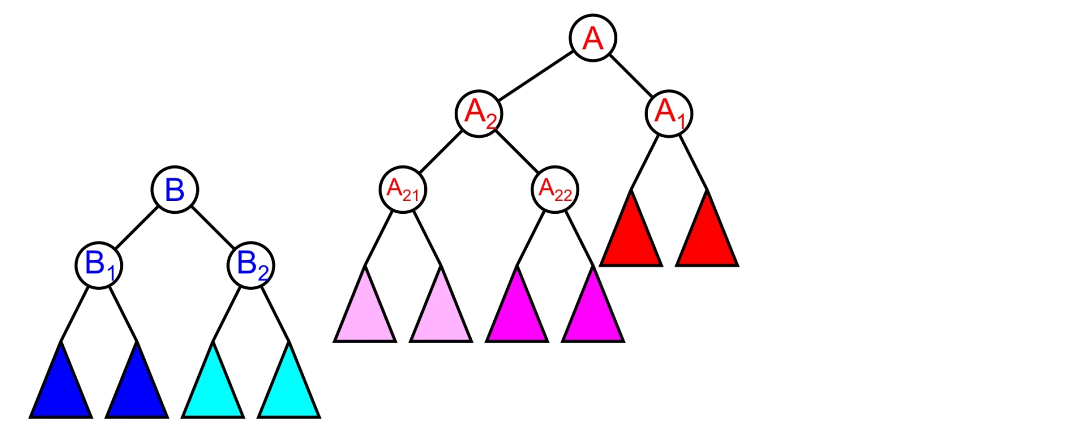
Merging
If, however, A₂ < B, we leave the heap A₂ in place

Slide 15
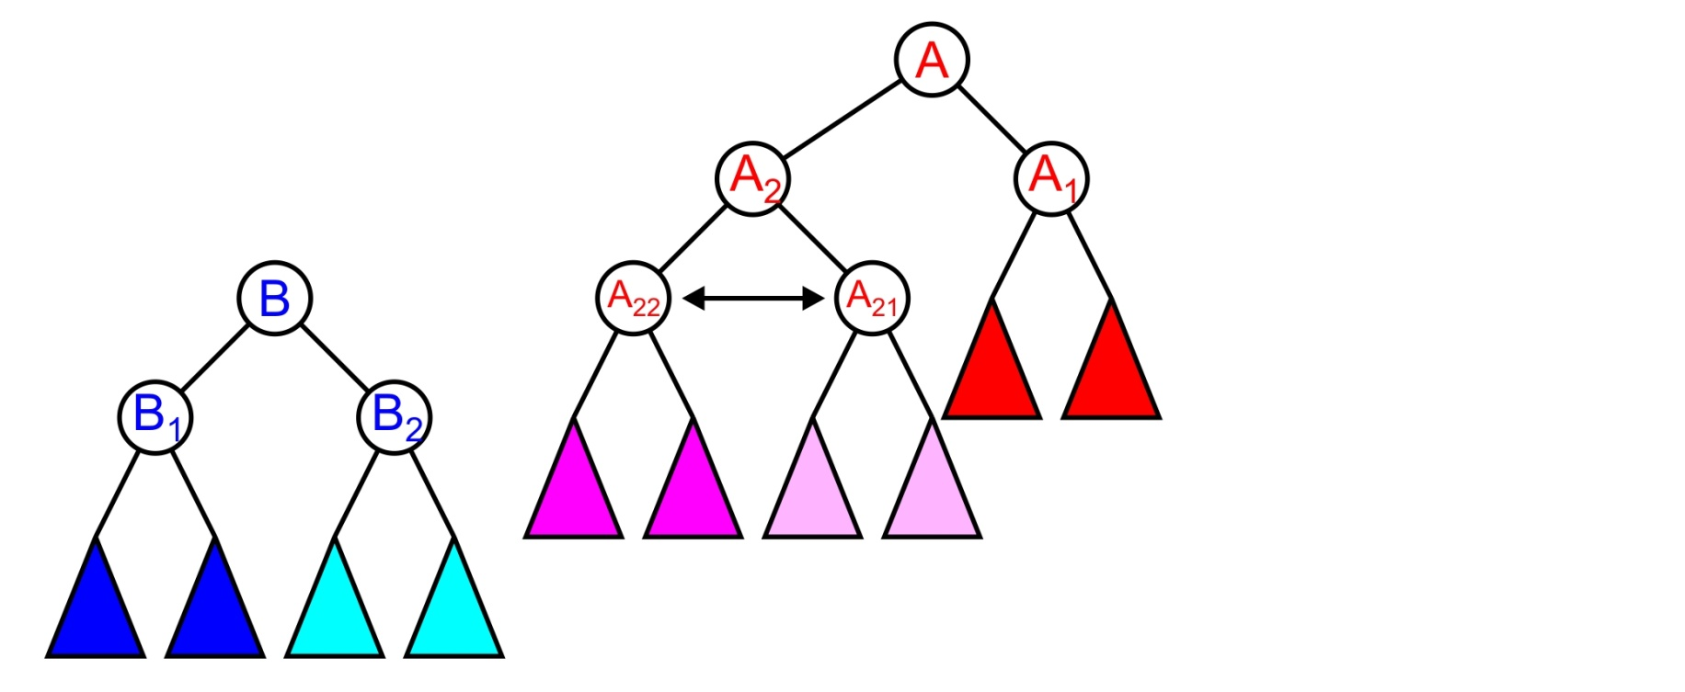
Merging
We swap the children of A₂

Slide 16
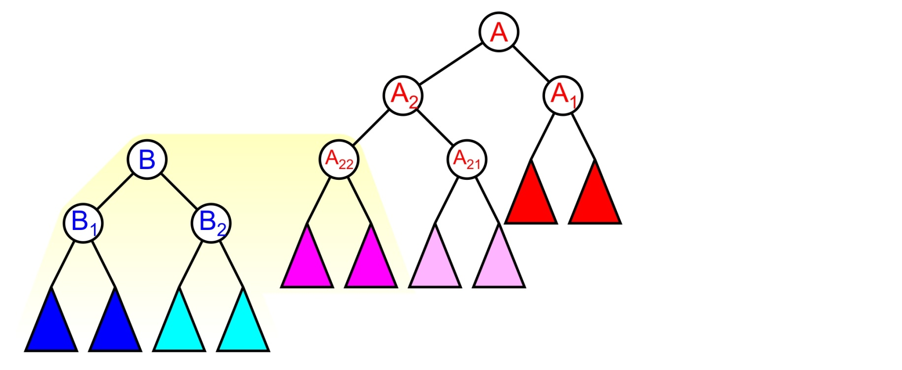
Merging
And proceed to merge the heap A₂₂ with the heap B

Slide 17
Merging
We recurse until we have attached the detached heap to an empty node

Slide 18
Implementation
An implementation of a leftist heap data structure is available at
http://ece.uwaterloo.ca/~dwharder/aads/Algorithms/Skew_heaps/

Slide 19
Summary
This topic has covered skew heaps:
Similar to leftist heaps, but it does not use the minimum null-path length
An individual operation may be O(n), but the amortized time is logarithmic

Slide 20
References
[1] Cormen, Leiserson, and Rivest, Introduction to Algorithms, McGraw Hill, 1990, §7.1-3, p.152.
[2] Weiss, Data Structures and Algorithm Analysis in C++, 3rd Ed., Addison Wesley, §6.5-6, p.215-25.

Slide 21
Usage Notes
These slides are made publicly available on the web for anyone to use
If you choose to use them, or a part thereof, for a course at another institution, I ask only three things:
that you inform me that you are using the slides,
that you acknowledge my work, and
that you alert me of any mistakes which I made or changes which you make, and allow me the option of incorporating such changes (with an acknowledgment) in my set of slides
Sincerely,
Douglas Wilhelm Harder, MMath
dwharder@alumni.uwaterloo.ca

